Slide 1

Family Engagement:
Using Mindfulness, Positive Role Modeling, and Self-Awareness to Promote Harmony and Growth
Presented by: Dr. Luke Bossard

Slide 2
Introductions
Who Am I?
Dr. Luke Bossard
Clinical Psychologist w/ Behavioral Pediatric & Family Therapy Program
Clinical Supervisor w/ Family Service of Lincoln
Dad of 4 ranging from 14 to 4
Who Are You?
My assumptions:
You are an ‘instrument of care’ to families
You are a ‘giver of self’ to enhance others
You are a mother, a father, an aunt, an uncle, a brother, a sister…

Slide 3

Objective #1:
Support Harmony in the Family

Slide 4
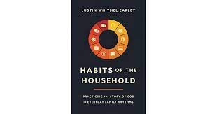
Objective #2:
Promote Growth in the Family

Slide 5
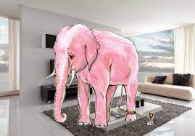
The ‘Elephant in the Room’

Slide 6
Word Association Game
Burnout
Chronic Fatigue
Vicarious Trauma
‘Compassion Fatigue’

Slide 7
“The Cost of Caring”
In 1995, Charles Figley defined “compassion fatigue” as “the cost of caring.”
We’ve talked about it but have we REALLY talked about it as it relates to our own mental health?

Slide 8
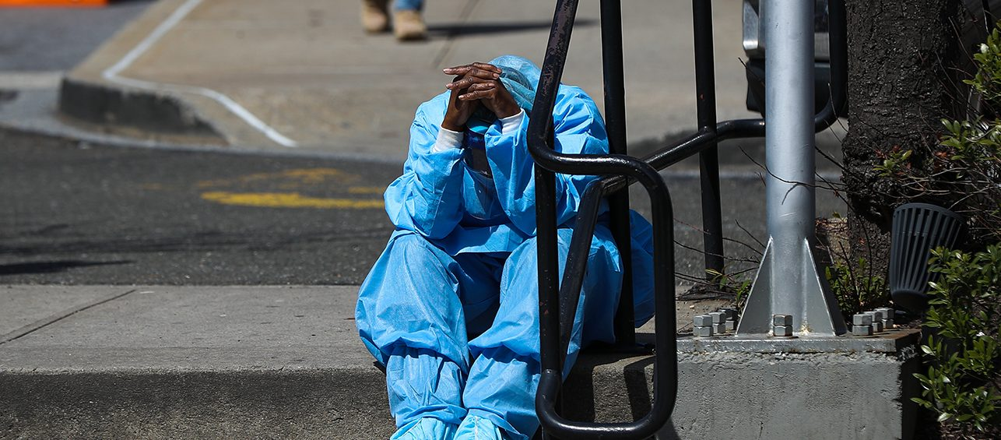
A nurse’s story
Nurse Supervisor- Lead Charge Nurse
At a hospital in Lincoln, NE

Slide 9
Question: What have you observed related to the morale of your team through this pandemic? Has it fluctuated with the ‘waves’?
“At the beginning, everyone was saying “this is why we became nurses!”
“About 6 months in, I noticed the team started ‘running on empty.’ It’s like we were dealing with “mass fatigue.”
Between waves, morale improved…
“But now people are walking around like zombies. We don’t have enough nurses. We’re short staffed. We deal with the daily stress of working with COVID patients.”

Slide 10
Question: How have you personally been affected by the job of not just caring for the sick COVID patients but also the team you lead?
“It’s stressful but
I try to be positive for everyone else.”

Slide 11
What are some of the ways that you have coped?
“I remind myself why I went into nursing. I’m a natural caretaker.”
“I am responsible for taking care of all of my patients and all of my staff.”

Slide 12

Can you relate?

Slide 13

What have been/what are your 3 greatest stressors as an ‘instrument of care’ since COVID hit?
Take a moment to consider
Write them down
If you are willing, share them in the chat

Slide 14

Family Distress and Fatigue

Slide 15
Your turn…
How have you seen
the impact of COVID
on the families with
whom you work?

Slide 16
A way forward…
Build Resiliency
&
Make Meaning-Making the Habit

Slide 17

Back to ‘Building Resiliency’
Astronaut Christina Koch
She spent a record 11 months in space,
the longest spaceflight of any woman.

Slide 18
Lessons she learned…
#1 “The biggest one that I think about is humility.“
  “Recognizing that it's OK to ask for help, to rely on the people around you. Being humbled, to be a part of something so great, …to be working with a team of people that are so good at what they do that can overcome these amazing engineering and scientific feats. So humility and incorporating that into my day to day has been a big take away of the mission.”

Slide 19
Lessons she learned…
#2 “building in resiliency”
“The human spaceflight program does a great job of this by making sure that we actually build in margin for everything we do, even though that might mean we take a hit on efficiency, we recognize that we always have to be ready for the unexpected. We don't know when that emergency is going to come. So we need an excess of power from our solar arrays. We need an excess of energy from our crew members. We need an excess of time in our ops tempo to accommodate that. So just like this pandemic, maybe teaching us that there is a balance between efficiency and resiliency.”

Slide 20
Take a moment to compare how Astronaut Koch talked about dealing with adversity versus how the charge nurse talked about dealing with adversity.
Who is more likely to experience burnout? Why?
Who will likely persist in the face of distress? Why?

Slide 21
Practice ‘Lived Self-Care’
- Self-initiated ongoing practice of taking an active role in protecting one’s well-being and happiness
Ideas for Therapists/Givers of Care
Ideas for Clients
Set boundaries
Sustain healthy escapes (i.e., breaks at the office, days off from the office)
Create a Flourishing Environment (i.e., enliven your office)
Make time for self-care! (i.e., exercise)
  Notice, value, and respond to our own needs as generously as you attend to others’ needs. Put it on the calendar
Resonate with your mission (i.e., connect to hope and optimism)
Foster creativity and growth
  ‘Professional Greenhouse’- learning environment where growth is encouraged
  ‘Play’ at work and outside of work
    Release endorphins, improve memory, enhance coping, express joy
    Associated with life satisfaction and well-being
Mind the body (i.e., sleep, eat, hydrate, exercise, get out in nature)
Nurture relationships
Restructure cognitions (i.e., not catastrophizing)
Cultivate spirituality
Foster optimism
Face fears
Solidify moral compass
Imitate resilient role models
Physical fitness
Enhance cognitive and emotional flexibility
Find meaning, purpose, and growth

Slide 22
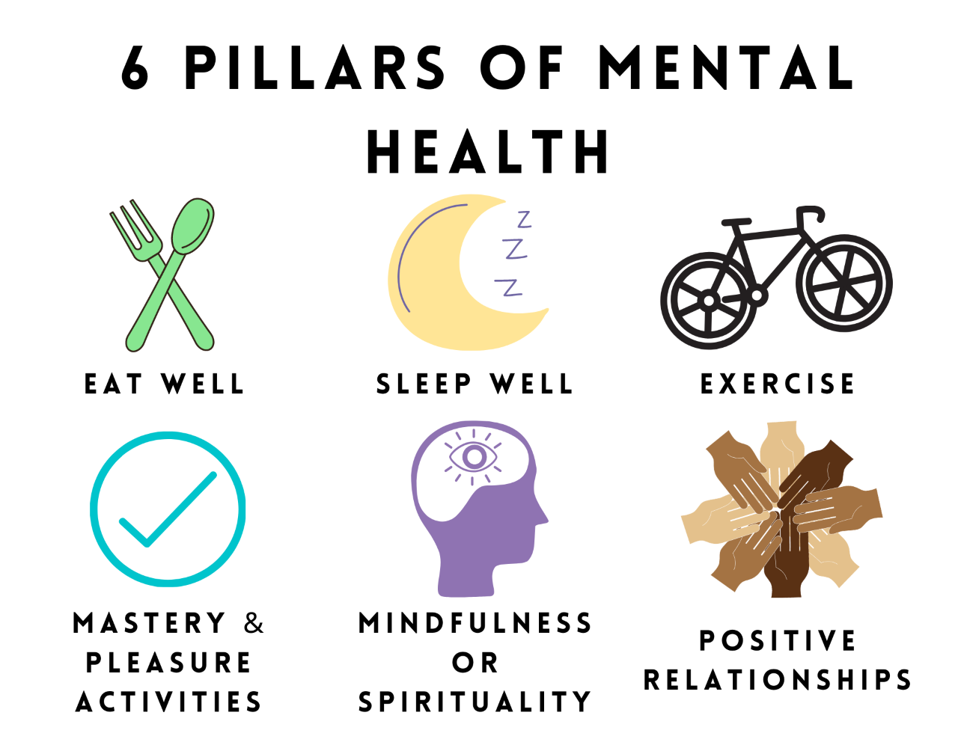
Take a look at Lifestyle
Maintaining all 6 is a great way to support sustained resiliency.

Slide 23

Time for Self-Care

Slide 24

Mindfulness as a Habit
One of my preferred grounding techniques to use with my clients is Body Scan
Encourages you and your clients to find a center point, a middle way,
through the surrounding CHAOS

Slide 25
Back to ‘Make Meaning-Making the Habit’
When we work with families, we need to determine the
‘Communal Habits’
-A pattern of shared habits intended to shape a community-

Slide 26
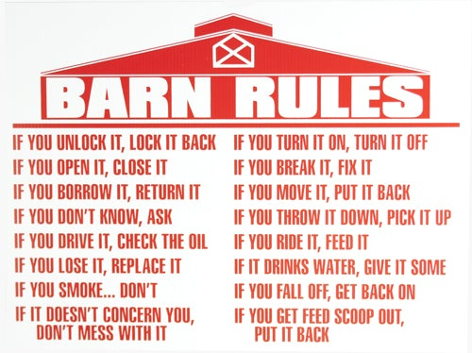

Slide 27
Think about your own household rituals…
How does your family start the day?
What are your family mealtimes like?
How does your family play together?

Slide 28
Overarching premise:
Habits of the Household
develop meaningful routines….
And Memorable Moments

Slide 29
‘Positive Role Modeling’
It’s not as much about what parents teach and say
but what they do….or allow…
(i.e. the road from letting Johnny stay home because he is nervous
to excessive truancies.)

Slide 30
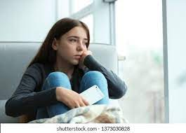
Consider the cost
Allowing families to follow default ‘cultural habits’ will continue to lead our children in a problematic direction.

Slide 31
What are some results of not choosing healthy household habits carefully in our modern world?
Patterns of excessive screen time
Constant busyness
Loneliness/Withdrawal
Unmitigated addictions
Chronic need for stimulation

Slide 32
Impact of ‘Cultural Habits’ on Adolescents
Communication Deficits
Depression (8% (2007),13% (2017) experience a diagnosable episode during teenage years)
Suicide (teens in rural areas are at greatest risk)
Anxiety (statistics tell us diagnosed anxiety disorder in teens is on the rise)
Drug & Alcohol Use
Gaming/Social Media Addictions
Obesity (about 20% of 12-19 year-olds are clinically obese)
Academic Problems

Slide 33
6 Habits of the Household
Waking
Mealtimes
Screentime
Play
Conversation
Bedtime

Slide 34
Assess:
“What do mornings look like at your house?”
Ask parents if they are waking up to ‘monsters’…
And we’re not talking about their kids!

Slide 35

Earley’s 3 ‘Monsters’ of the Morning
Waking to scanning work emails = Waking to the ‘Monster of Performance’

Slide 36

Earley’s 3 ‘Monsters’ of the Morning
Waking to social media=
Waking to the ‘Monster of Comparison’

Slide 37

Earley’s 3 ‘Monsters’ of the Morning
Waking to (many) news sources=
Waking to the ‘Monster of Fear and Anger’

Slide 38
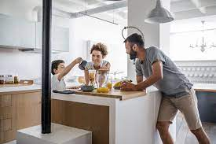
Instead…
Create the Ritual of ‘Gather and Send’

Slide 39
Ideas for the morning
Parents will create the habit of keeping their phone out of sight, notifications off
Is there a way to playfully bring the child to the ‘place of communing?’
Discover meaningful ways to join together before leaving each other for the day:
  Cuddling on the couch
  Eating breakfast together
  Packing lunch together
  Listening to music the family enjoys
  Saying a prayer together
  Walking with them to the bus stop

Slide 40
Assess:
“What are mealtimes like at your house?”
Family therapist Anne Fishel says only about 30% of families regularly eat dinner together
“In affluent families the numbers have gone up, and in low income families they've gone down, which I think speaks to the extra stressors of having to work extra jobs, having unpredictable schedules, and not having as much access to healthy food.”

Slide 41
Family Dinners are hugely important…
80% of teenagers say that family dinner is the time of the day they're most likely to talk to their parents.
Regular family dinners are associated with lower rates of depression, anxiety, substance abuse, eating disorders, higher rates of resiliency and higher self esteem.
Kids who grow up having family dinners, tend to eat more healthily and to have lower rates of obesity later in life.

Slide 42
What is really at the center of mealtimes?
COMMUNING, not consuming
It's not so much the act of eating together as much as it is about connection, and engaging in quality time together
(I know this is hard to pull off, especially with young children)

Slide 43
Ideas for mealtimes
Involve the children (or A child) in meal prep or setting the table
No electronic devices at the table
Introduce a semi-structured communication activity (i.e. ‘pass the pepper’ or ‘best and worst of the day’)
It’s where relationship building CAN happen…in it’s raw, unvarnished, and sometimes chaotic form
For more ideas, check out:
The Family Dinner Project – thefamilydinnerproject.org

Slide 44
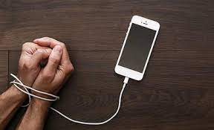
Assess:
“What are the screentime habits at your house?”
What writer Justin Earley terms:
‘The Fight for Formation’

Slide 45
The reality
Our Children are constantly being shaped…
there is no neutral.
Parents need to make a decision about exposure.
The decision will have a great deal to do with what morals and values their children align.

Slide 46
Parenting is hard…and it’s nonstop…
But has the parent formed a ‘screentime rut’ in their child as a result of the desire for peace and quiet?
We have inadvertently created a problem of high stimulation activity seeking in our children.

Slide 47
Ideas for limiting and monitoring screens…
1. Determine the limit of time spent on screens and follow-through
2. Set other expected rhythms:
  Introduce regular family activities
    Friday night family movie night
    Screenless car rides
    Regular trips to the YMCA
    Saturday dog park trips
    Encourage time with grandparents
    Engage in regular outdoor activities (i.e. fishing)
    LET THE KIDS WRESTLE WITH BOREDOM
3. Choose acceptable content well
  Pick media that either expands imagination or educates the mind (i.e. Duolingo)
  Be present when media is used

Slide 48
Assess:
“How does your family engage in play?”
Why is play important?
  Play Builds Imagination and Creativity
  Play Fosters Cognitive Growth
  Play Delivers Emotional Benefits
    - When adults feel overwhelmed, we retreat into activities that soothe us (play). We go to the gym, sing karaoke with friends, walk around the neighborhood, or play a board game.
    - In children, frequent, daily play can help reduce anxiety, stress and irritability. It also helps boost joy and self-esteem.
  Play Improves Literacy
  Play Encourages Greater Independence
    - Particularly when children engage in solitary play
  Play Promotes Physical Fitness

Slide 49
Ideas for Forming the ‘Habit of Play’…
Parents are encouraged to cultivate imagination and joy in engagement with children in play
Get in the habit of accepting a child’s invitation to play
If a parent is gone at work for much of the day, 30 minutes of concentrated time for presence is recommended when they return
A parent who is home with kids all day must not feel guilty about not playing constantly, but 10-30 minutes of focused engagement can go a long way toward meaningful connection

Slide 50
Ideas for Forming the ‘Habit of Play’…
Parents should not bring devices to play time with kids
Send children outside to play on their own
  Make them comfortable with the struggle against boredom
Reading books aloud to children is a wonderful way to bond the family together
  Kids 5 and over would enjoy The Chronicles of Narnia
  My wife and 11-year-old daughter have read all of the Harry Potter books together in the past year

Slide 51
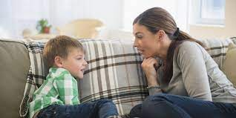
Assess:
“What does conversation sound like in your home?”
Conversation is the learned art of friendship

Slide 52
Nurture the ‘habit of finding rhythms of
1-on-1 conversation’ in the home
The art of friendship requires practice with conversation
We befriend each other in the home to train children to go out and befriend the world

Slide 53
Ideas for Forming the ‘Habit of Conversation’…
1. Pursuing one-on-one moments
  Talking during morning cuddles
  Chatting after a TV program or movie (‘Wonder Years’ evenings with my son)
  Jogging and talking, ‘Feelings Football,’ raking leaves together
  Special outings (Daddy-daughter date nights)
  Create a pleasant space for conversation

Slide 54
Ideas for Forming the ‘Habit of Conversation’…
2. Practice Conversation as a Way to Heal Trauma
  The parent provides a place of safety and offers ‘wise counsel’
  Parents cannot always protect children from trauma but can identify trauma and repair after the trauma has occurred

Slide 55
Ideas for Forming the ‘Habit of Conversation’…
3. Model Vulnerability
  Honesty from children often happens when their parent is honest first
  Vulnerability from children often happens when their parent demonstrates it
  The conversation happens because the parent seeks the child out

Slide 56
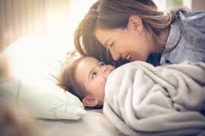
Assess:
“What does bedtime look like at your house?”
Bedtime is the moment at the end of the day to express love and grace

Slide 57

‘Let it Go’
‘Grace’ in this context means letting go of earlier frustrations and modeling restoration of the relationship.

Slide 58
Ideas for Forming the Habit of Reconnection and Extending Grace
Parents should do a personal emotional inventory to identify lingering frustrations at bedtime
Before entering a bedroom, engage in any grounding or de-escalation necessary to be composed
Decide to either ‘move on’ from earlier frustrations or briefly seek closure
Create a habit the child looks forward to
  Story telling
  Book reading
  Teaching diagnostics ☺
If the child triggers anger, step out, de-escalate, and return once composed
Model grace
Always express love

Slide 59
How do I get started on all of this?
Begin wherever you are or
wherever the family you are working with is.
Then courageously strive for
‘small accomplishments’…

Slide 60
My hope and desire…
That your efforts to teach families to engage routinely in Meaning-Making ways…
…will promote Harmony
&
Growth

Slide 61

Questions?
I will take a couple of questions that have been compiled in the chat.

Slide 62
Thank you so much for participating & for your commitment to work with Families!
If you have follow-up questions or feedback that might help me to provide improved future talks, contact me at:
lbossard@bpandftp.com

